Slide 1
9/22/2025

Slide 2
Have Completed
Wrote code to acquire all ball bearing trial data, for 1st application and 1st reapplication (15 trials each) into one large dataframe
This code can be easily modified for all other tests such as beaker and slow to fast movement
One large dataframe for ADC strain data containing 15 trials of 1st application and 15 trials of 1st reapplication
One large dataframe for IMU data containing 15 trials of 1st application and 15 trials of 1st reapplication
Used empirical quadratic curve fit of 1st block calibration data to determine angles for strain sensor

Slide 3
Next Steps
Compare Strain Angle data to Camera Data – Error Analysis
Compare IMU angle data to Camera Data – Error Analysis
Compute norm ROM for each participant
Computer T2TV for each Participant
This analysis should go quickly -> 1 day once camera data is in

Slide 4
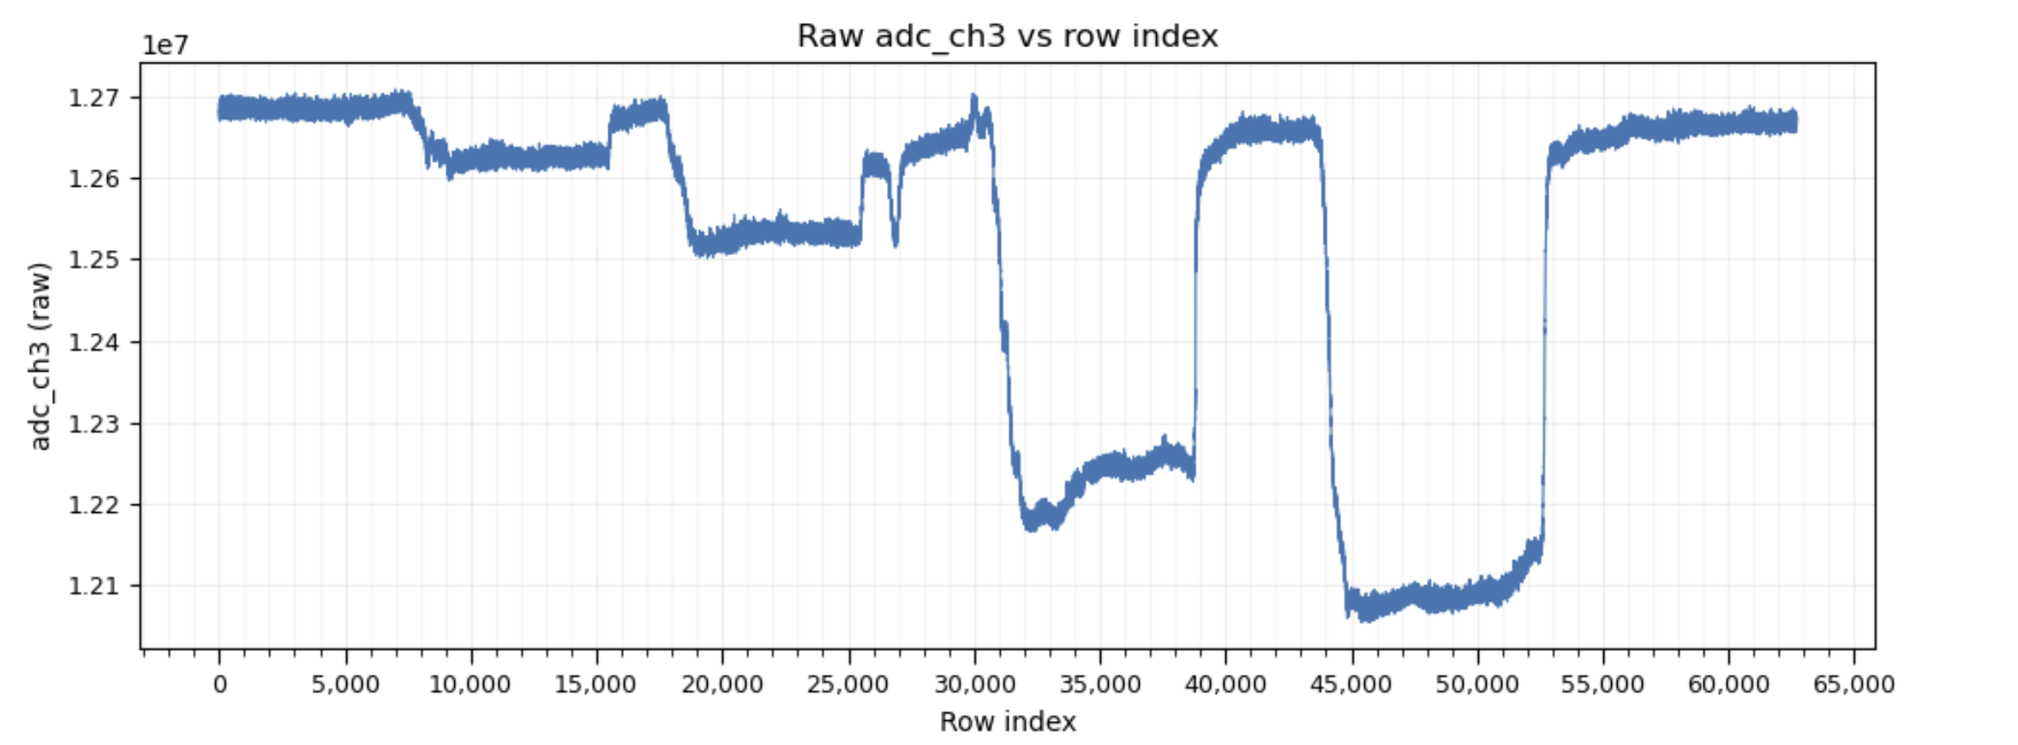
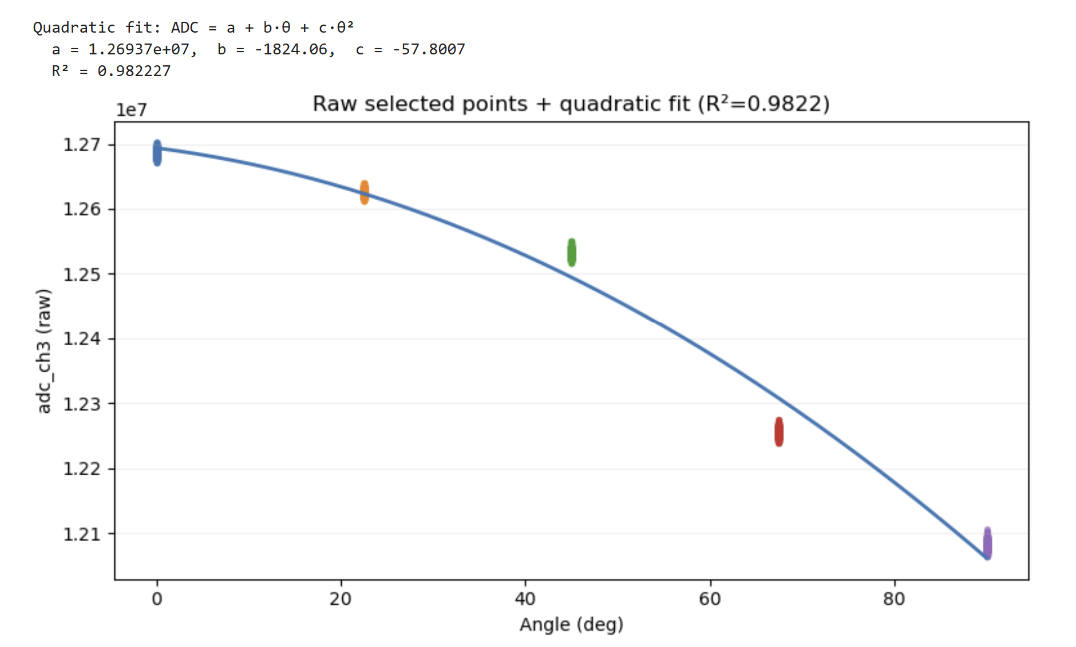
Block Calibration Data -1st Application Only
Raw ADC Data and Quad Curve Fit
Visually acquired 500 consecutive points (row index)
0 deg
22.5 deg
45 deg
90 deg
67.5 deg

Slide 5
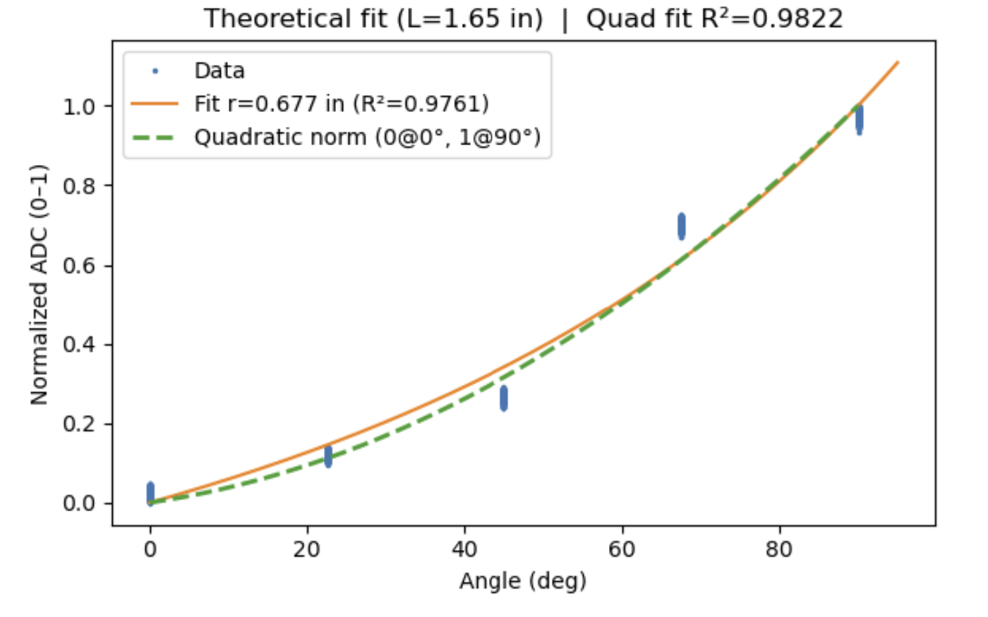
Block Calibration Data -1st Application Only
Raw ADC Data and Quad Curve Fit
Norm 0 to 1 Quad Curve Fit (green) + Theor Curve Fit
Used curve fit above to determine adc at 90 deg, and adc at 0 deg. These 2 pts served as max and min for norm 0 to 1 analysis, so that any other collected data can be scaled accordingly between 0 and 1.

Slide 6
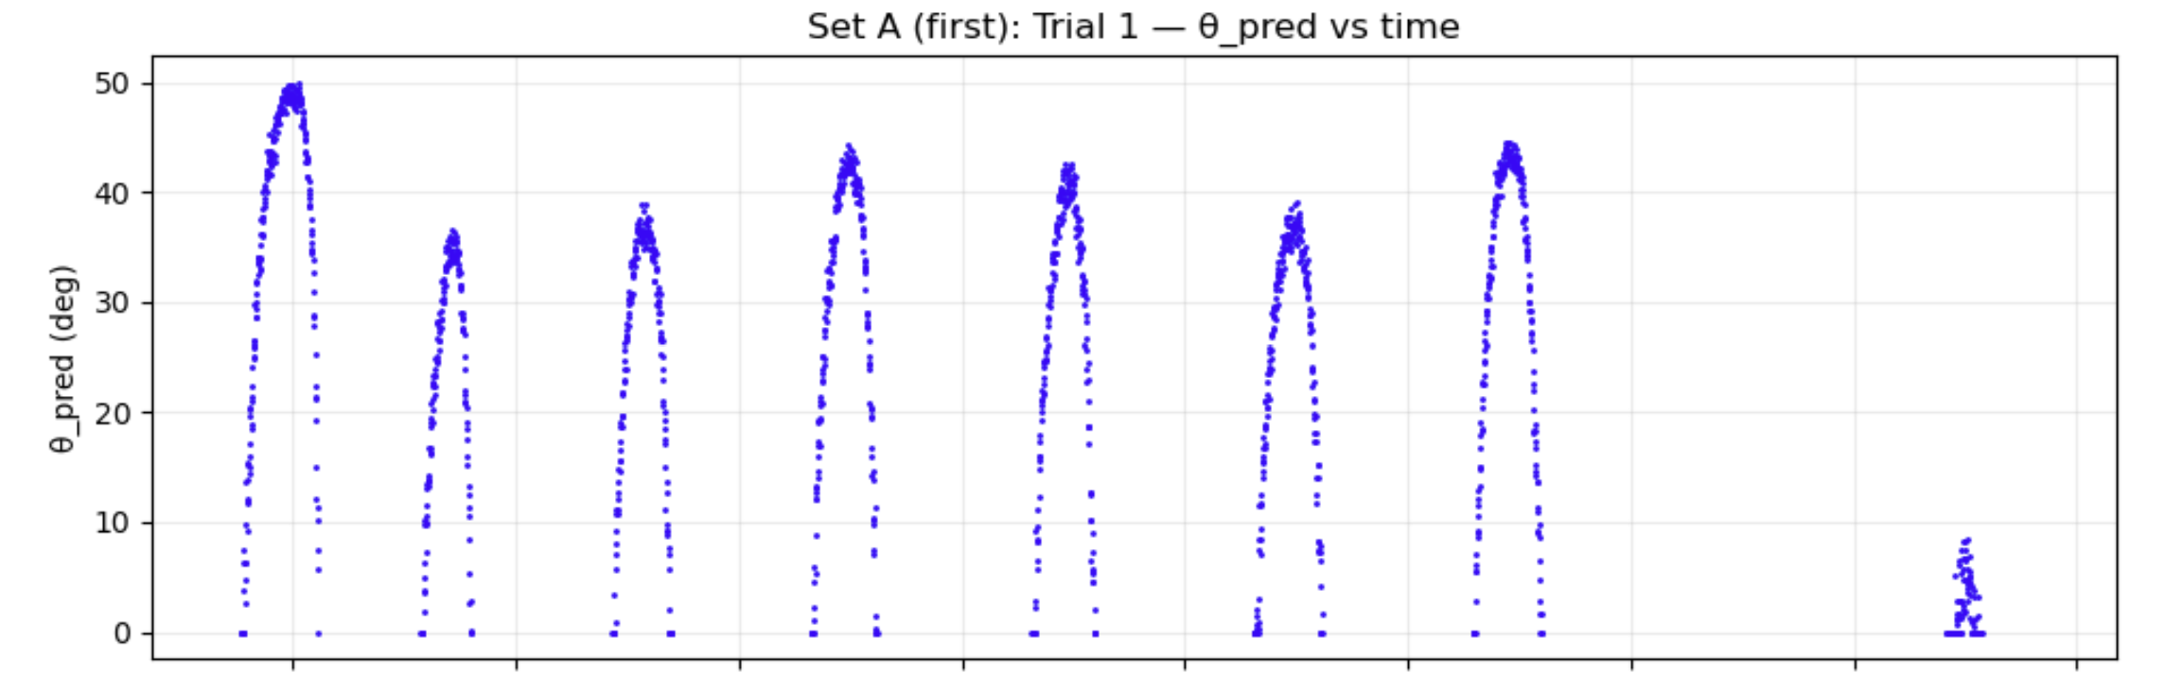
Strain Sensor Results – 1 Ball Bearing Trial (Blue = 1st application)
10 seconds

Slide 7
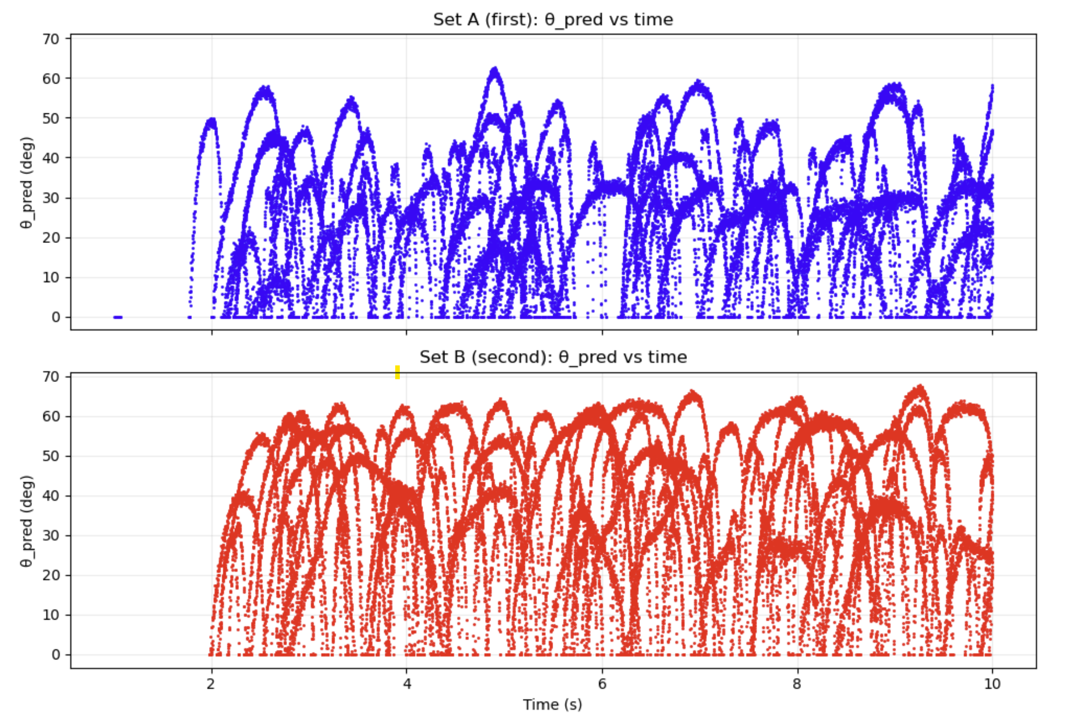
Strain Sensor Results – All 15 Ball Bearing Trials (Blue = 1st application, Red = 2nd)

Slide 8
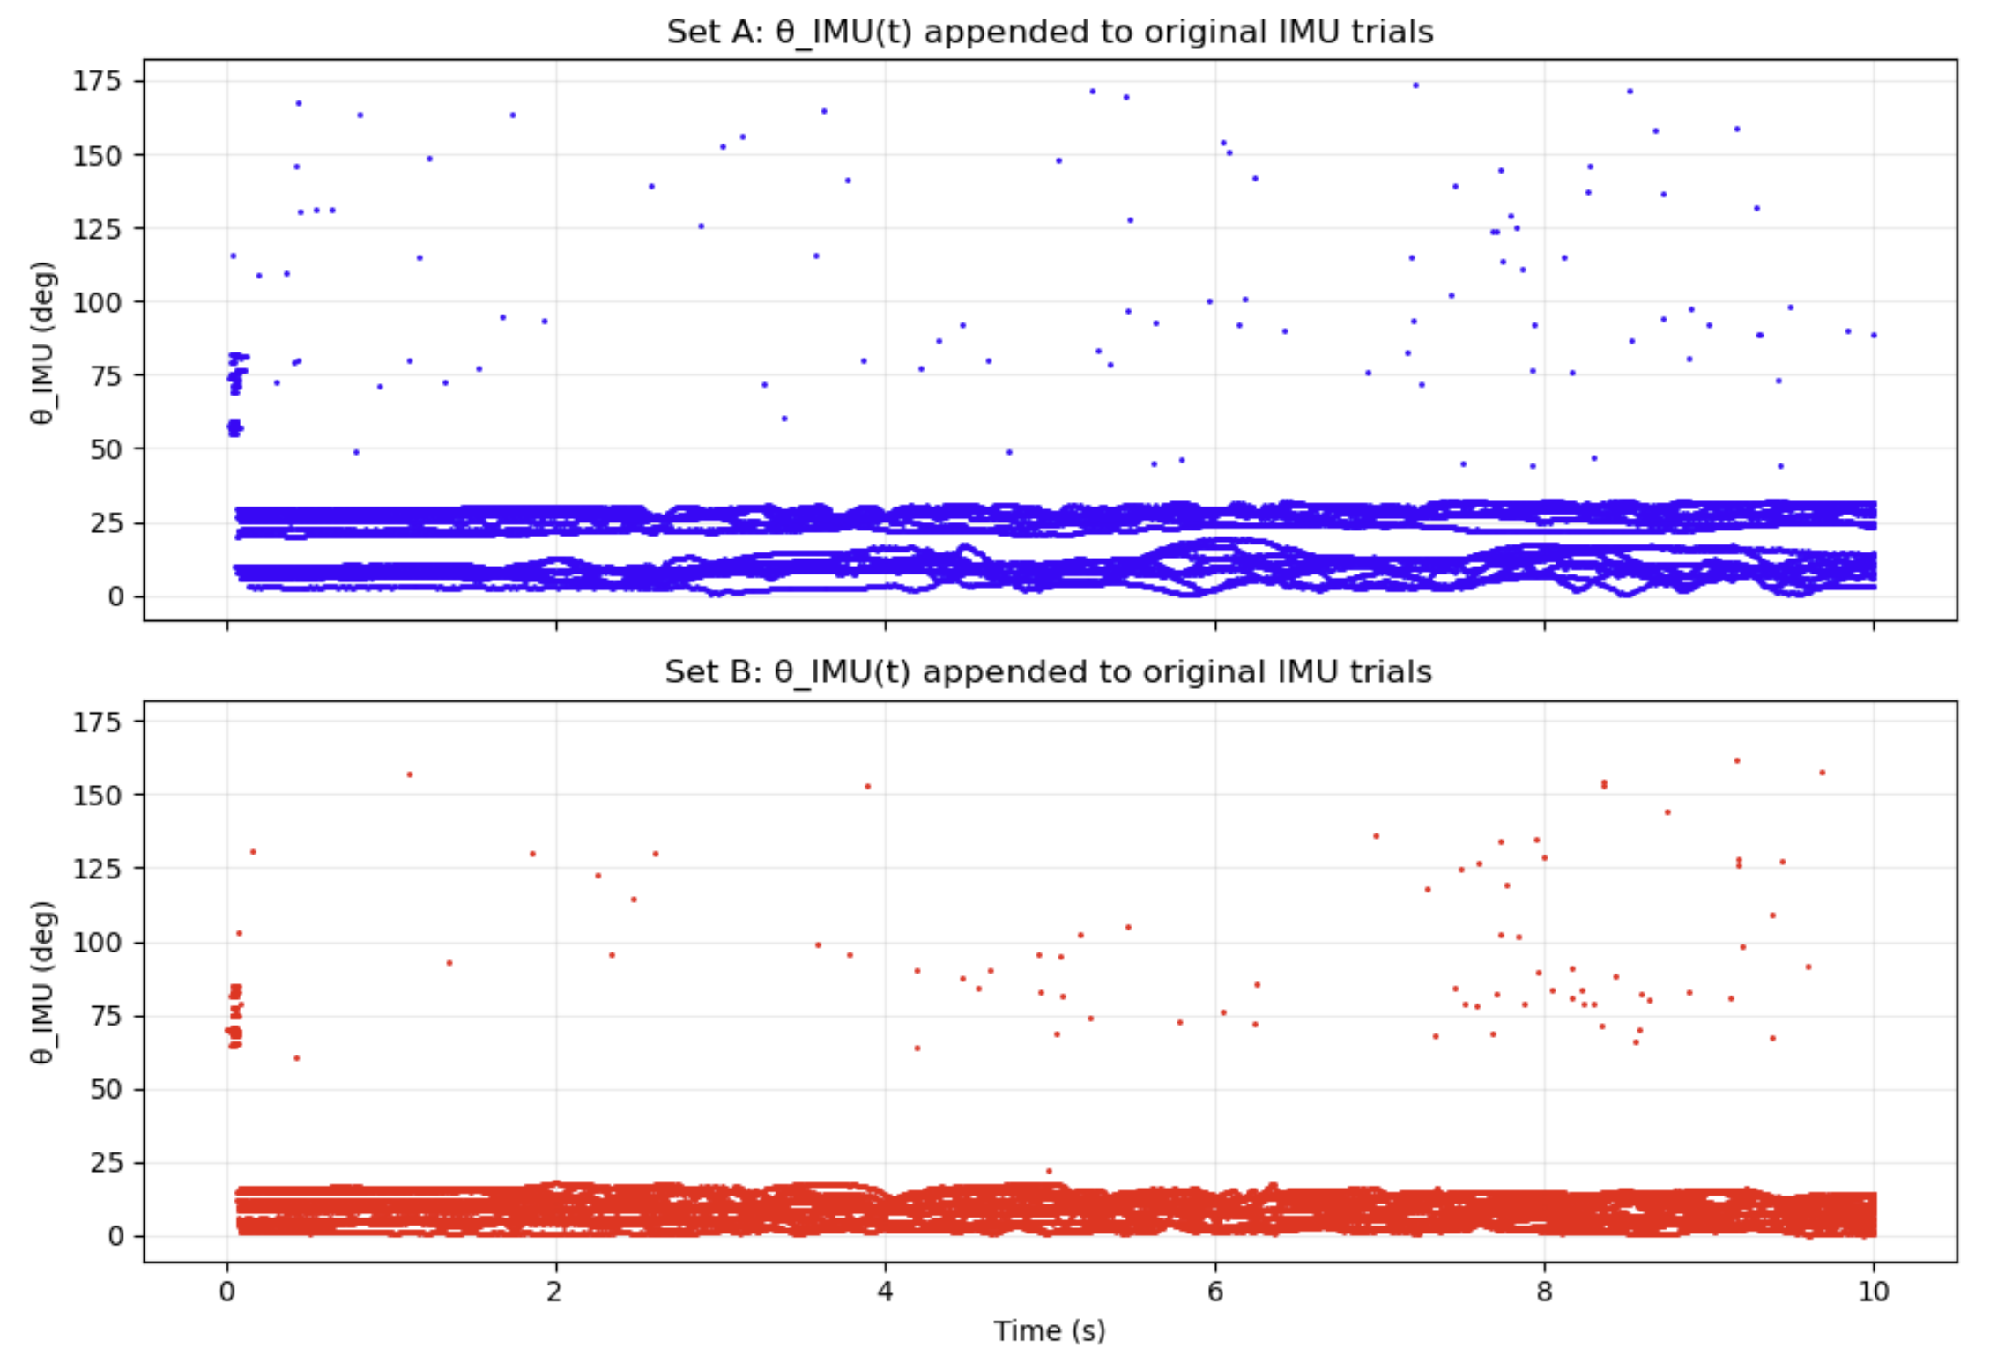
IMU Results – All 15 Ball Bearing Trials (Blue = 1st application, Red = 2nd)

Slide 9
9/15/2025

Slide 10
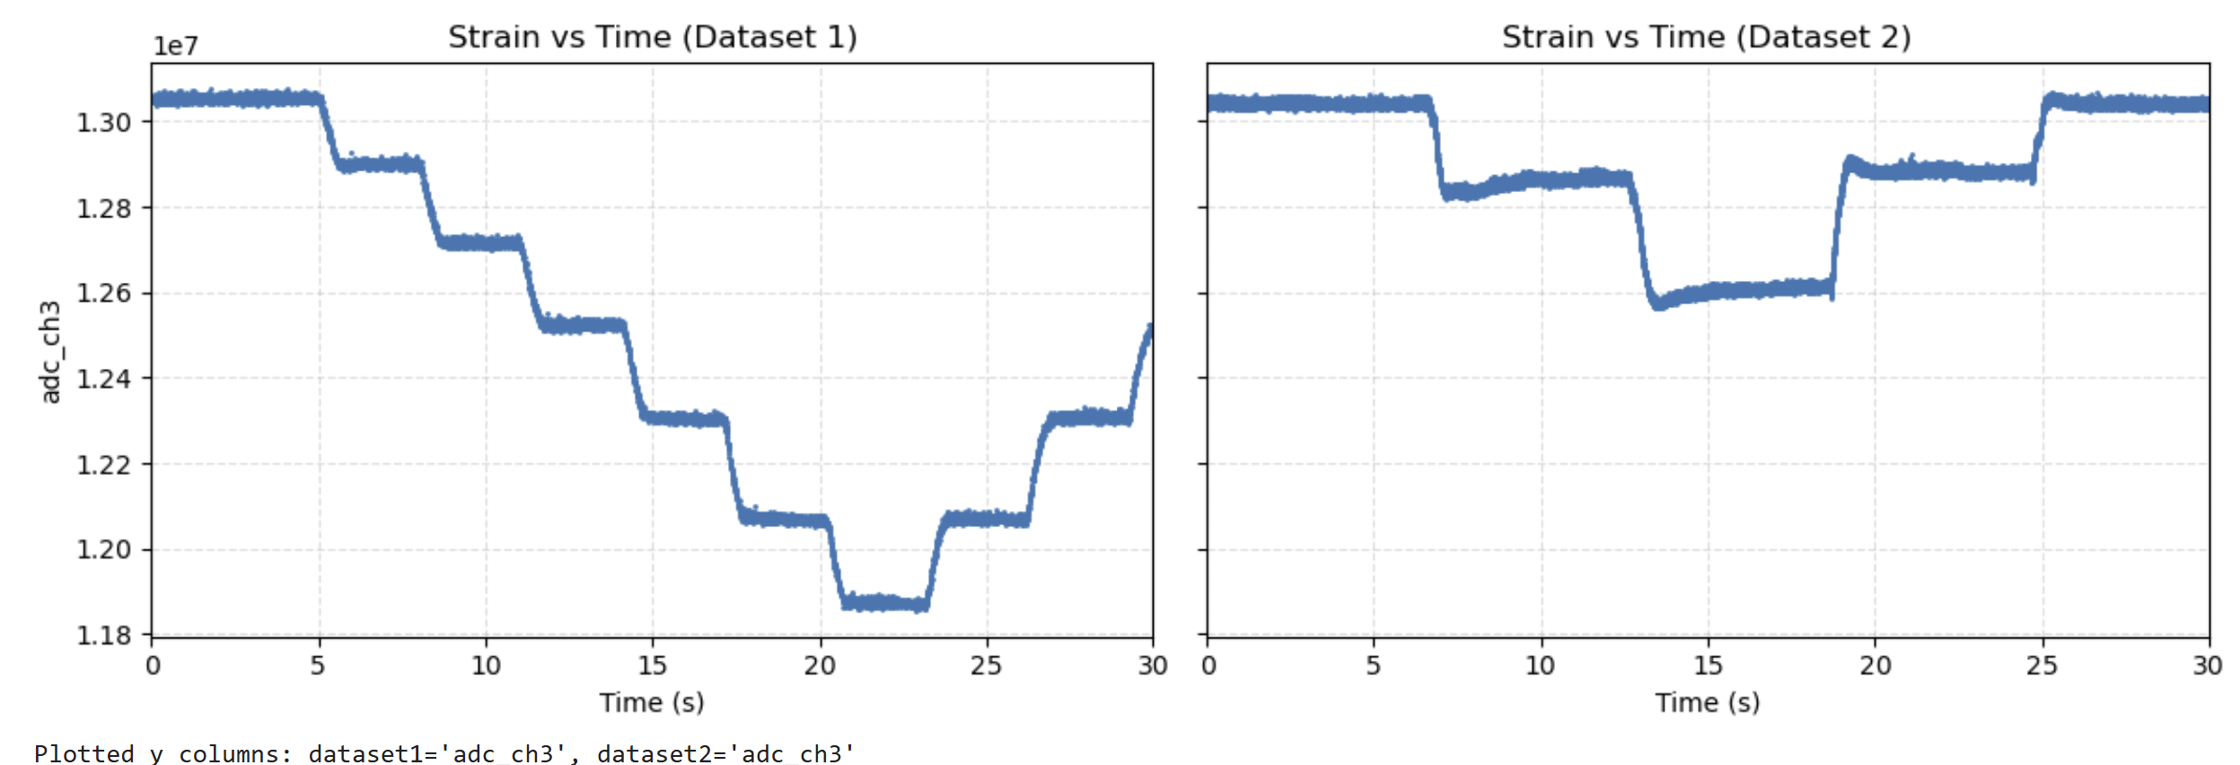
1st Autobender Strain Calibration
1st Hand on Autodender Strain Calibration

Slide 11
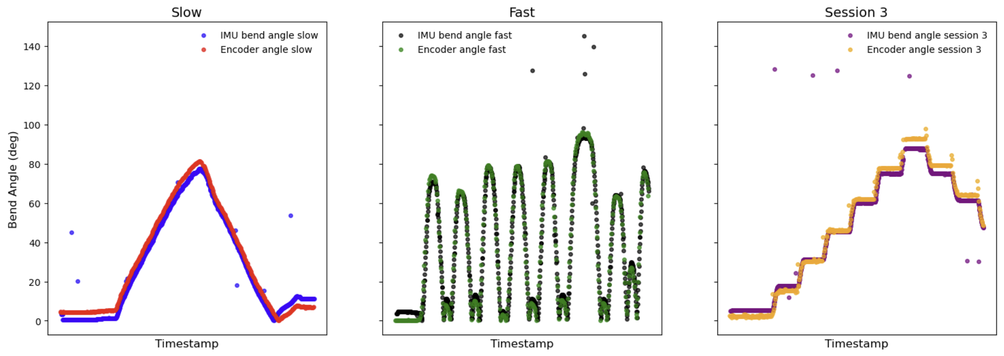
IMU’s on Autobender

Slide 12
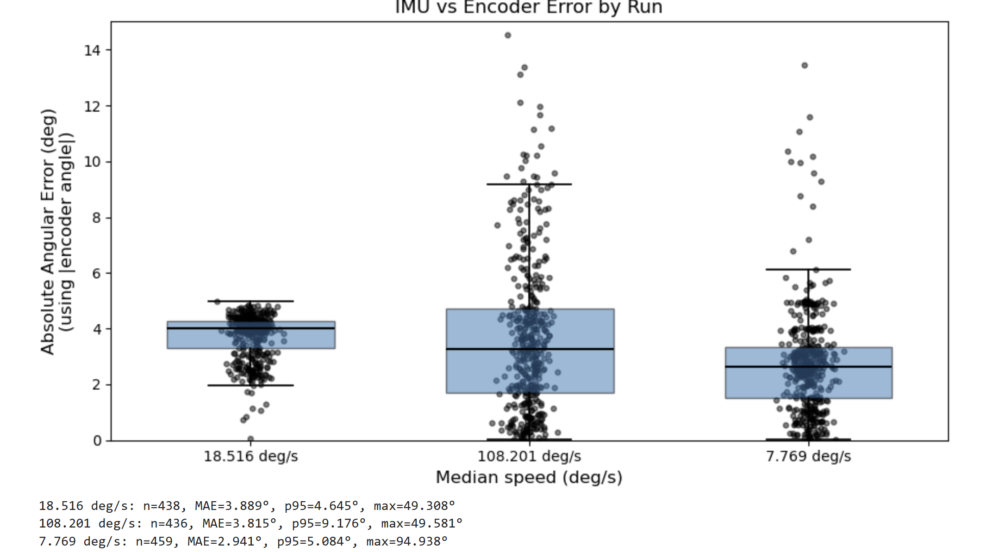
IMU’s on Autobender

Slide 13
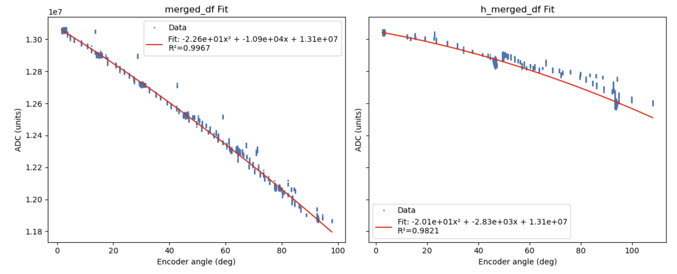
1st Autobender Strain Calibration Curve Fit of Raw Data
1st Hand on Autodender Strain Calibration
Curve Fit of Raw Data
If not including data between autobender jumps (data recorded continuously, unlike autobender studies last year where data only recorded every 15 degs), curve fit improves drastically.

Slide 14
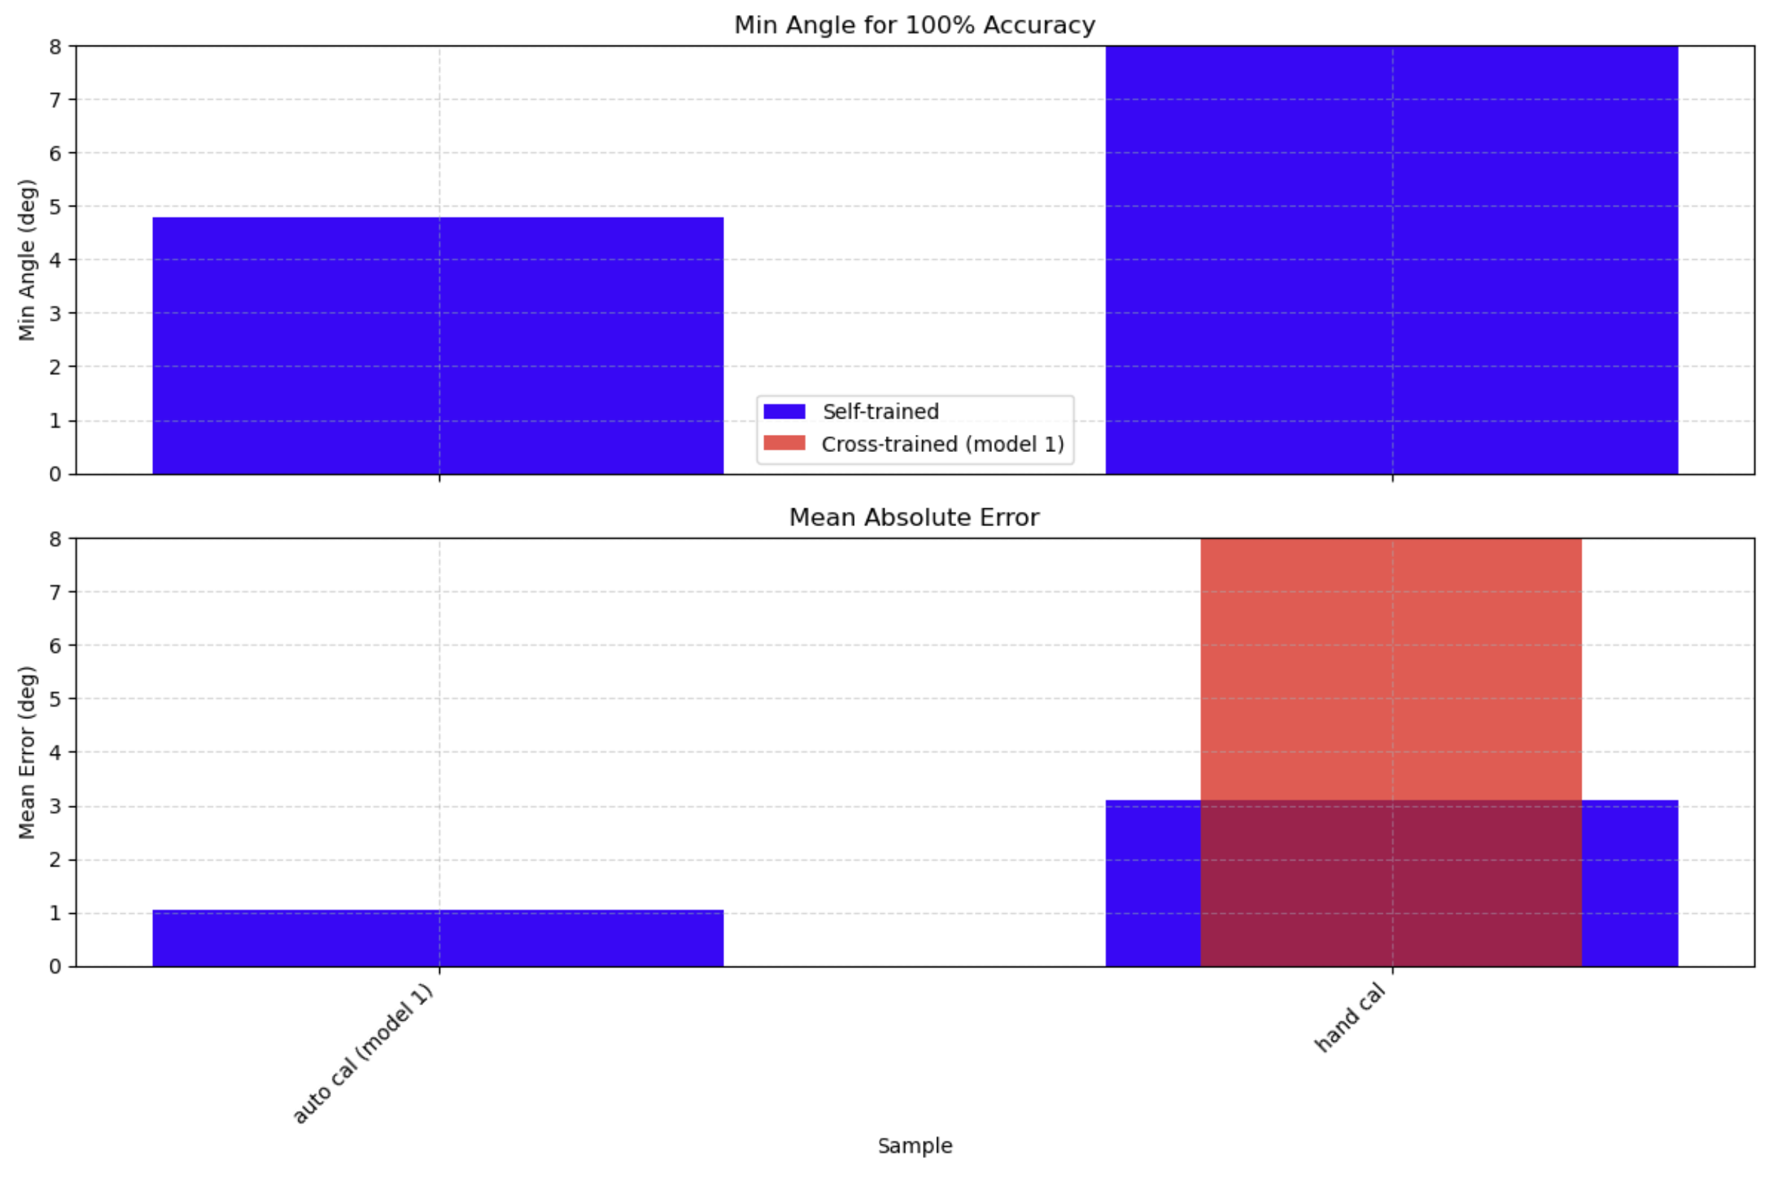
Autobender Norm 0 to 1 model used to fit Hand Norm 0 to 1 Data, as in previous data

Slide 15
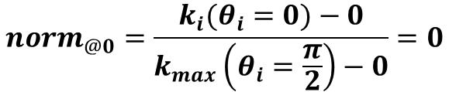
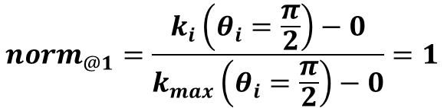
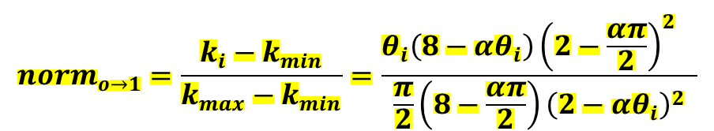
$$ε=αθ, where α=\frac{c}{L} , epsilon=strain or\frac{ΔL}{L}, c=knuckle radius, L=sample length$$
$$\frac{ΔR}{R_{o}}=\frac{ρLε}{whR_{o}}\left[\frac{8−ε}{{\left(2−ε\right)}^{2}}\right]=k, where R_{o}=initial resistance$$
$$norm_{o→1}=\frac{k_{i}−k_{min}}{k_{max}−k_{min}}=\frac{θ_{i}\left(8−αθ_{i}\right){{\left(2−\frac{απ}{2}\right)}^{2}}^{}}{\frac{π}{2}\left(8−\frac{απ}{2}\right){\left(2−αθ_{i}\right)}^{2}}$$
$$norm_{@1}=\frac{k_{i}\left(θ_{i}=\frac{π}{2}\right)−0}{k_{max}\left(θ_{i}=\frac{π}{2}\right)−0}=1$$
$$norm_{@0}=\frac{k_{i}(θ_{i}=0)−0}{k_{max}\left(θ_{i}=\frac{π}{2}\right)−0}=0$$

Slide 16
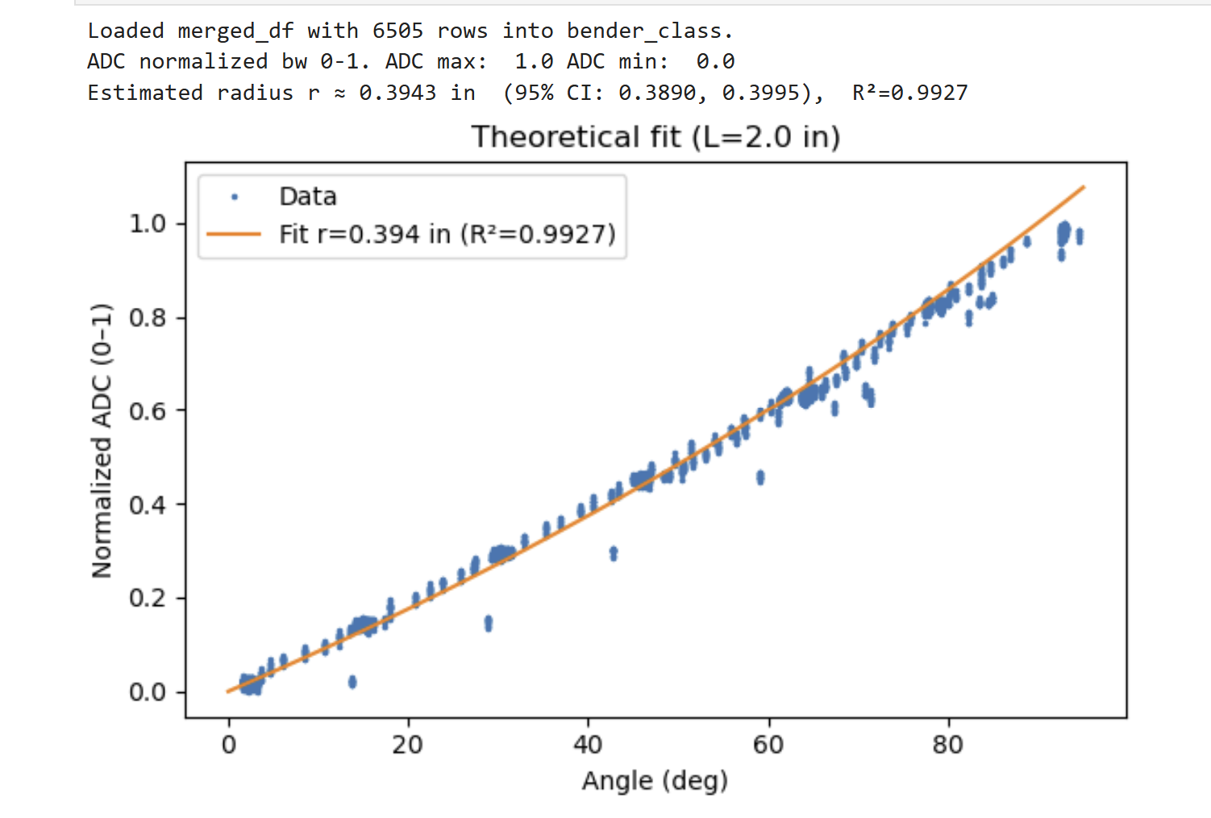
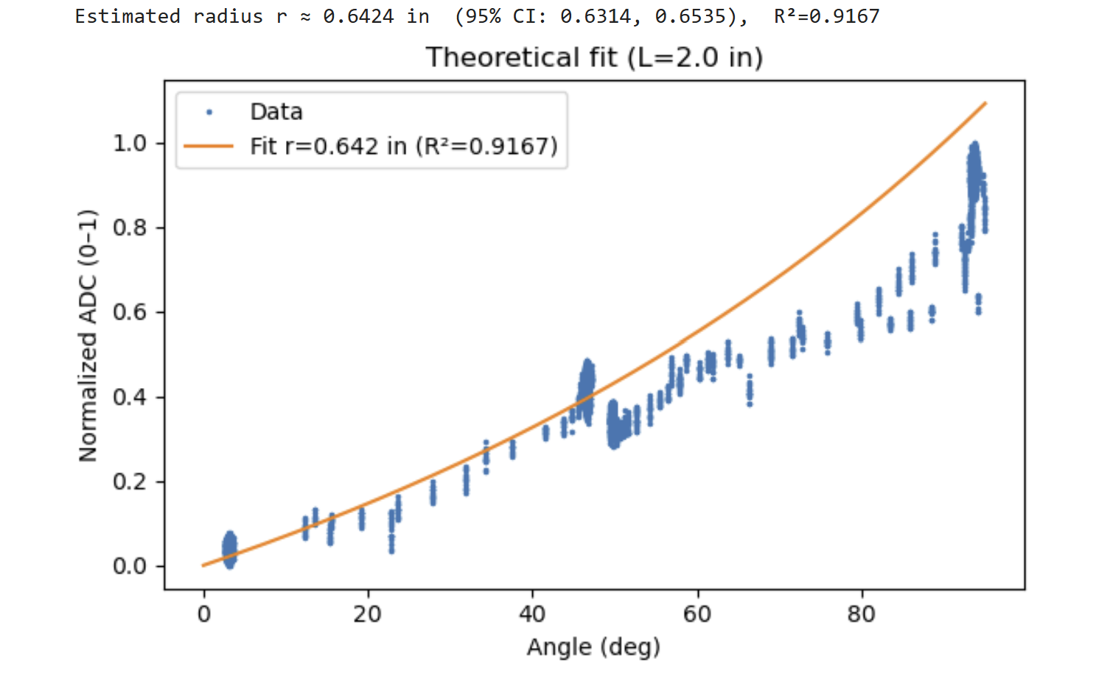
Theoretical Model used To Fit Autobender (Left) and Hand (Right) Data
1st Autobender Theor Curve Fit of Raw Data
1st Hand on Autodender Theor
Curve Fit of Raw Data

Slide 17
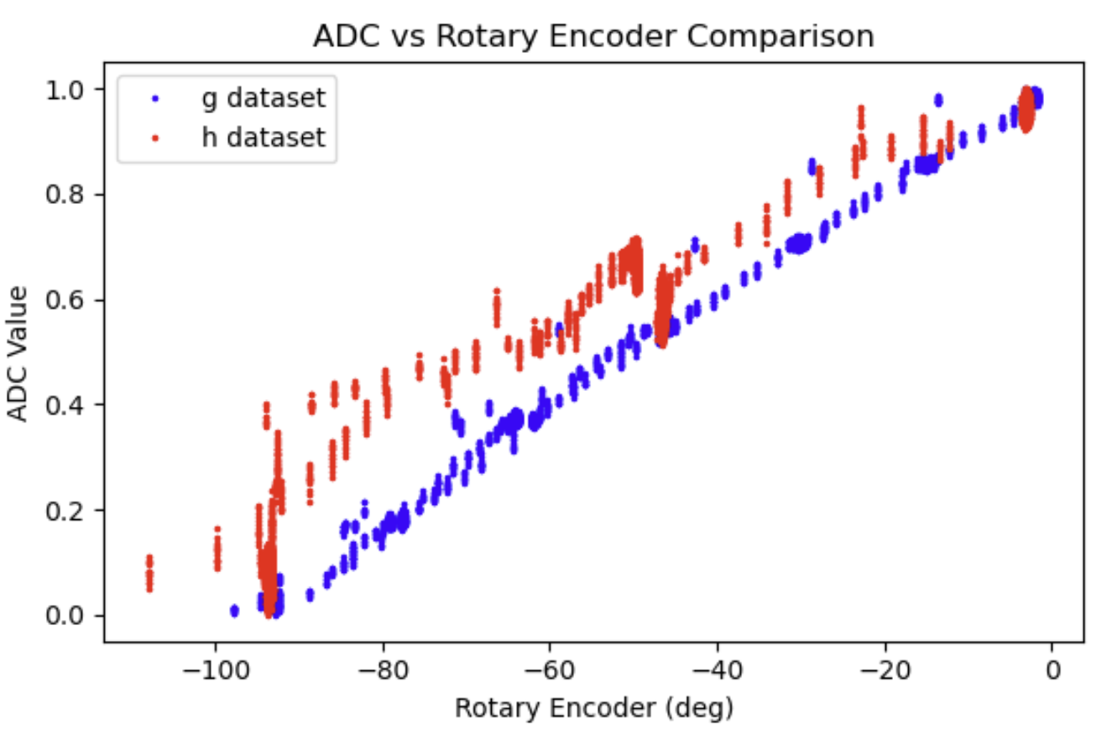

Slide 18
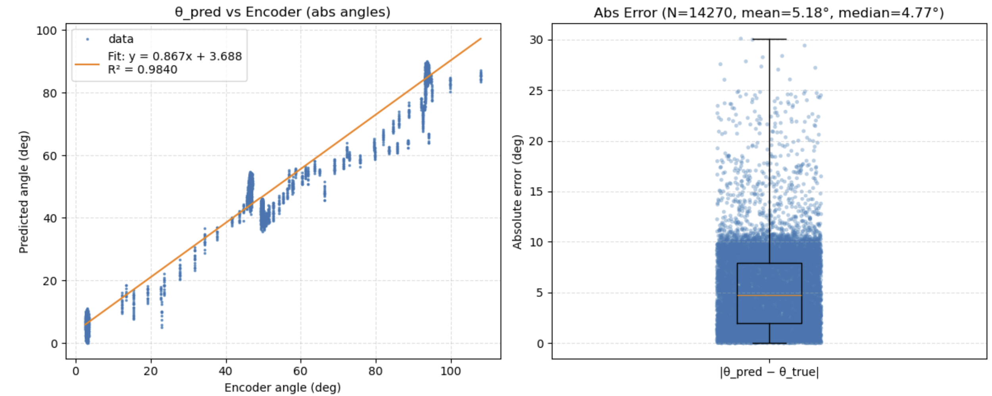

Predicted Angle Based on Measured Knuckle Radius
From raw adc
Measured Radius
$$norm_{o→1}=\frac{θ_{i}\left(8−αθ_{i}\right){{\left(2−\frac{απ}{2}\right)}^{2}}^{}}{\frac{π}{2}\left(8−\frac{απ}{2}\right){\left(2−αθ_{i}\right)}^{2}}$$
Abs Error

Slide 19
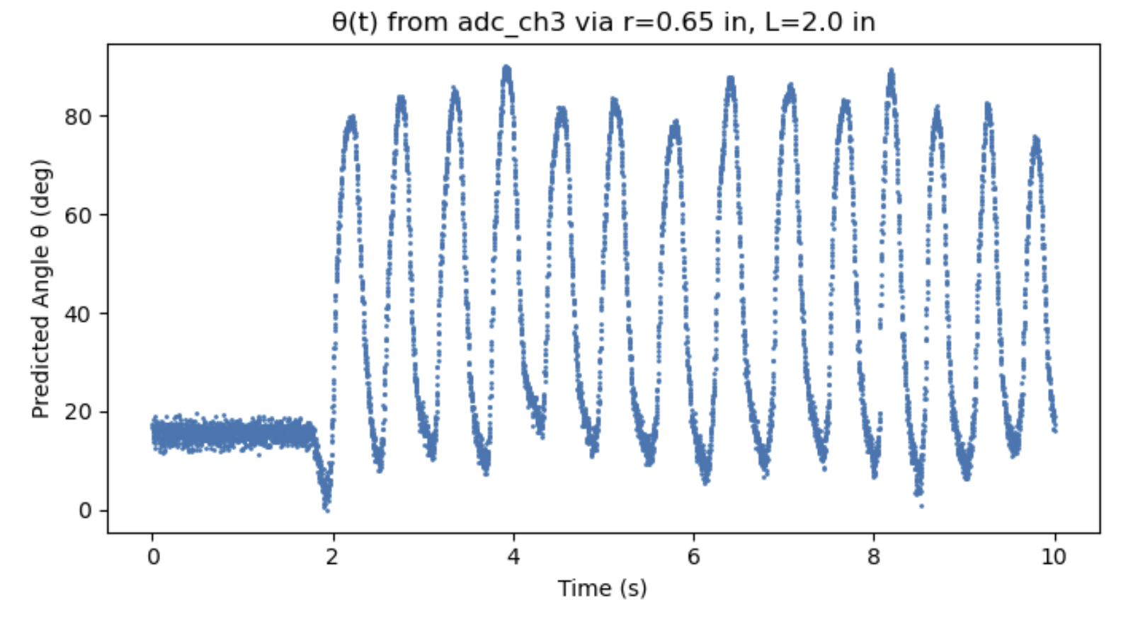
1 Trial of Bending Finger AFAP

